Slide 1
CSCI 558L Lecture 9: IP Address, ARP, and ICMP
Internetworking and Distributed Systems Laboratory
Young Cho
Department of Computer Science
University of Southern California
Slides adopted from Rice

Slide 2
IP Address
IP version 4 addresses are 32-bits
Version 6 address are 128 bits
Every network interface has at least one IP address
A computer might have 2 or more IP addresses
A router has many IP addresses
These addresses can be assigned statically or dynamically
IP addresses are always in big-endian byte order (network byte order)
True in general for any integer transferred in a packet header from one machine to another
E.g., the port number used to identify a TCP connection

Slide 3
IP Address Format
IPv4 addresses are usually displayed in dotted decimal notation
Each byte represented by decimal value
Bytes are separated by a period
IP address 74.125.53.147 = 0x4A7D3593
IP addresses are hierarchical
Address is composed of a network ID and a host ID
www.usc.edu: 74.125.53.147

Slide 4
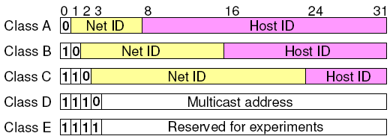
IP Address Structure
IPv4 Address space divided into classes:
Special IP addresses
Loop-back address: 127.0.0.1
Unrouted (private) IP addresses:
10.0.0.0 – 10.255.255.255
172.16.0.0 – 172.31.255.255
192.168.0.0 – 192.168.255.255
Class | Start address | Finish address
A | 0.0.0.0 | 127.255.255.255
B | 128.0.0.0 | 191.255.255.255
C | 192.0.0.0 | 223.255.255.255
D | 224.0.0.0 | 239.255.255.255
E | 240.0.0.0 | 255.255.255.255

Slide 5
Routing
Routing using Classes
Internet router only using network IDs
Organization can route based on host IDs
Address classes were too “rigid”
Class C is too small and Class B is too big in many situations
Inefficient use of address space and a shortage of addresses
Not enough Class B networks
In case they grew to more than 255 hosts
But there are only about 16,000 Class B network IDs
Larger organizations wanted many Class C networks
Separate network ID for each router link
Router in the Internet had to know every network ID
Leads to large address tables in every router

Slide 6
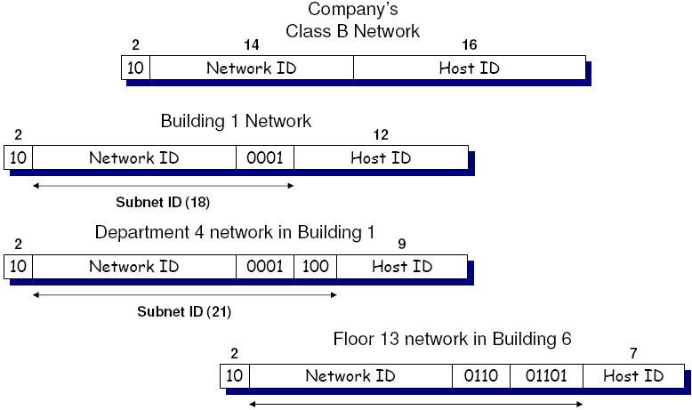
Subnetting
Divide the network within an organization
Class network as a collection of smaller networks
Size can be selected by the organization
Internet routers don’t need subnet information
Just route their traffic to the organization

Slide 7
Subnetting
Can recursively subnet addresses down
Minimum-sized subnet is 4 addresses
i.e. 0 names the subnet, 3 is broadcast, 1-2 are hosts
A.B.C.D/X
IP address of the subnet (with 0’s in all host ID bits)
X = number of bits in the subnet network address
Examples:
17.0.0.0/8 – Apple’s entire class A address space
17.2.3.0/24 – A class C sized subnet in Apple’s network
Alternatively represented by subnet IP and a bit mask (netmask)
17.0.0.0/255.0.0.0
17.2.3.0/255.255.255.0

Slide 8
Subnet Meaning
No physical meaning
Although easier to keep track of if they do
Good subnet assignment simplifies routing for internal routers
All traffic for “building 1” goes through this port
All traffic for “department 3” goes through that port
Organization
128.0.0.0/8
A group may be encoded in the second octet:
128.A.0.0/16
A building may be encoded in the third octet:
74.A.B.0/24
Routers aggregate routes for group then buildings

Slide 9
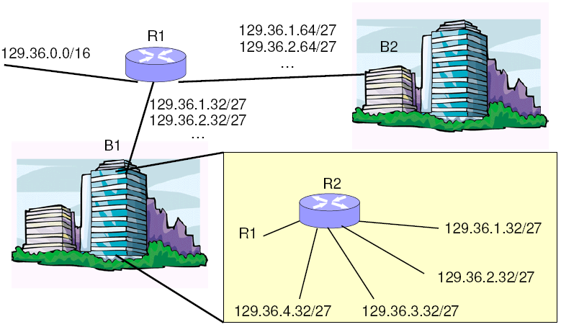
No Route Aggregation

Slide 10
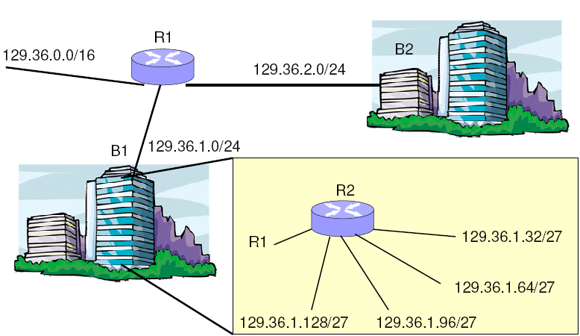
Route Aggregation

Slide 11
Classless Inter Domain Routing
CIDR introduced in 1993
Meant to provide more flexible routing
Eliminate dependences on “class” networks in routing
“Supernetting”
Combine multiple contiguous networks into one larger network
Effectively reduces the number of entries needed in each routing table
Inverse of subnetting which takes one larger network and breaks it into multiple contiguous smaller networks

Slide 12
CIDR Concept
Same type of aggregation as with subnets, but on a larger scale
One ISP handles traffic for two corporate networks
i.e. 129.32/16 and 129.33/16
Aggregate route to 129.32/15 for both networks
Only break them apart when necessary for the last (few) hop(s)
One ISP handles all 64/8 networks
All other routers know to route 64/8 traffic to that ISP
External routers don’t care how ISP breaks the space
Internal ISP routers must route at a finer grain

Slide 13
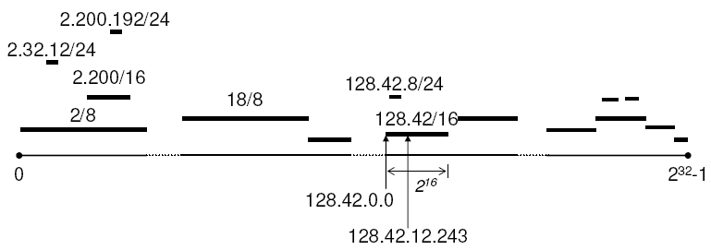
IP Prefixes
IP address space can be viewed as a number line
Each segment represents an aggregated route
Segments can overlap
Look for smallest segment that matches the destination

Slide 14
Longest Prefix Match
Allow more specific entries to supersede more general ones
128.42.8/24
Route this traffic to Italy
128.42/16
Route this traffic to Houston
Except for addresses that match a route with a longer prefix (i.e., 128.42.8/24)
Allows significantly more route aggregation
Simplifies things if companies move (physically or to another ISP) their block of IP addresses

Slide 15
IP Address Classes
CIDR makes address classes less important
Routing based on arbitrary subdivisions of address
Aggregate routes into largest possible group
Use longer prefixes to deal with exceptions
Internet Routers
Use longest prefix matching to determine routes
No longer deal with matches on class network IDs

Slide 16
Software Longest Prefix Matching
Simple software solution
Keep list of prefixes and masks
Search for all prefix matches
Choose result with longest prefix
Easy Improvement
Sort list based on decreasing prefix length
Stop search after first match
Inefficient for large forwarding tables
Are there better methods? (Hash? Search Alg)

Slide 17
Hardware Longest Prefix Match
Ternary CAM
Use “don’t care” for bits outside the prefix
All matching prefixes will yield a hit
Pick the one with the longest prefix
Simple Improvement
Sort CAM entries based on decreasing prefix length (use lowest matching entry)
Also does not scale for larger tables

Slide 18
IP Routers
IP routers determine next hop using LPM
Given a destination IP address, what is the IP address of the router to which the datagram should be forwarded next?
Why do they need the next hop IP address?
Destination IP address remains unchanged in the datagram
Actually need the next hop Ethernet address
Review
Ethernet address
Unique identifier for a piece of hardware
IP address
Unique identifier for a system performing a function
Address Resolution Protocol

Slide 19
Address Resolution Protocol
Find link layer using network layer
i.e., what is the Ethernet address for a given IP address?
Every IP hosts/routers has an ARP table
Map IP to Ethernet addresses on their LAN
May be incomplete
Can include both static and dynamic entries

Slide 20
Static ARP Entries
Example
IP address 74.23.121.45 has Ethernet address 00:E0:81:A4:23:EF
Must be managed by the sysadmin
Actively managing IP to Ethernet address mappings for all nodes in a LAN would be difficult
What if that NIC fails and is replaced?
What if that system’s IP address is changed?

Slide 21
Dynamic ARP Entries
Systems “discover” IP Ethernet address mappings, as needed
Each entry has an IP address, an Ethernet address, and a timeout (typically around 20 minutes)
ARP packets are broadcast on the LAN to discover mappings
ARP packets are encapsulated in Ethernet frames

Slide 22
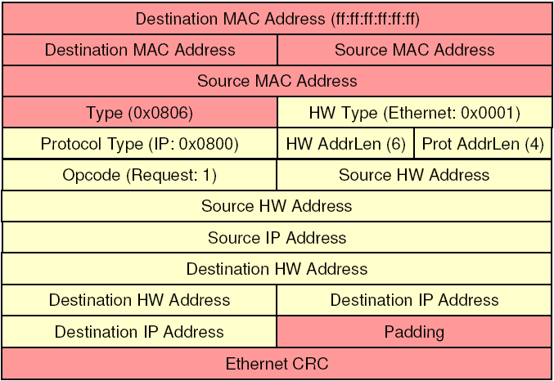
ARP Request

Slide 23
Sending a Packet from a Host
Host setup
IP address
Subnet – what IP addresses are on the same LAN
Gateway – where to send traffic outside the LAN
Destination on LAN
Create ARP request for destination IP
Broadcast to everyone on the LAN
Destination should reply with its MAC address
Destination not on LAN
Create ARP request for gateway IP
Broadcast to everyone on the LAN
Gateway should reply with its MAC address

Slide 24
Learning MAC Addresses
Hosts learn IP to Ethernet address map
ARP responses are stored in ARP tables
ARP requests are stored in ARP tables (whether the host is the target or not!)
ARP entries time out
Allow machines to change IP and/or MAC addresses transparently
Eliminate stale entries (machines turn off, move, crash, etc.)

Slide 25
Forwarding a Packet in a Router
Lookup dest IP address in forwarding table
Yields a next hop port and IP address
If not found, drop packet
Lookup packet DA in forwarding table.
If known, forward to correct port.
If not found (in particular: no default router), drop packet
Decrement TTL, update heade Checksum.
Forward packet to outgoing interface
Transmit packet onto link

Slide 26
Forwarding Decision
1. Given a packet: determine the network prefix of the destination in the packet (CIDR!)
2. Is the destination on the same network?
Use own address and subnet mask
3. If found, immediate destination = final destination
4. Else, use routing table to find immediate destination
5. Use ARP to find datalink (MAC) address
6. Send packet over to datalink immediate destination

Slide 27
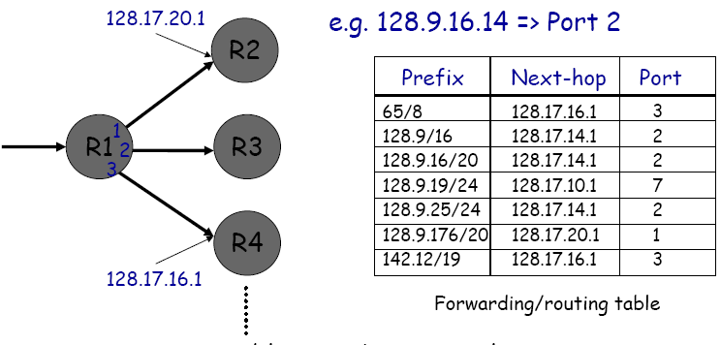
Routing Table

Slide 28
Internet Control Message Protocol
ICMP is a helper protocol for IP
Error reporting
Simple queries
Encapsulated as IP datagrams
Header
Type (1 byte): type of ICMP message
Code (1 byte): subtype of ICMP message
Checksum (2 bytes): checksum is calculated over entire ICMP message
If there is no additional data, 4 bytes are set to zero.
Each ICMP messages is at least 8 bytes long

Slide 29
ICMP Query message
ICMP query:
Request sent by host to a router or host
Reply sent back to querying host

Slide 30
Example of a Query: Echo Request and Reply
Ping’s are handled directly by the kernel
Each Ping is translated into an ICMP Echo Request
The Ping’ed host responds with an ICMP Echo Reply
Host or Router
Host or router
ICMP ECHO REQUEST
ICMP ECHO REPLY

Slide 31
Example of a Query: ICMP Timestamp
A system (host or router) asks another system for the current time.
Time is measured in milliseconds after midnight UTC (Universal Coordinated Time) of the current day
Sender sends a request, receiver responds with reply
Sender
Timestamp Request
Receiver
Timestamp Reply

Slide 32
ICMP Error message
ICMP error messages report error conditions
ICMP error messages include the complete IP header and the first 8 bytes of the payload (typically: UDP, TCP)
Typically sent when a datagram is discarded
Error is often passed from ICMP to the apps

Slide 33
Example: ICMP Port Unreachable
RFC 792: If, in the destination host, the IP module cannot deliver the datagram because the indicated protocol module or process port is not active, the destination host may send a destination unreachable message to the source host.
Request a service at a port 80
Client
Server
No process is waiting at port 80
Port Unreachable

Slide 34
Frequent ICMP Error message
Type | Code | Description
3 | 0–15 | Destination unreachable | Notification that an IP datagram could not be forwarded and was dropped. The code field contains an explanation.
5 | 0–3 | Redirect | Informs about an alternative route for the datagram and should result in a routing table update. The code field explains the reason for the route change.
11 | 0, 1 | Time exceeded | Sent when the TTL field has reached zero (Code 0) or when there is a timeout for the reassembly of segments (Code 1)
12 | 0, 1 | Parameter problem | Sent when the IP header is invalid (Code 0) or when an IP header option is missing (Code 1)

Slide 35
Some subtypes of the “Destination Unreachable”
Code | Description | Reason for Sending
0 | Network Unreachable | No routing table entry is available for the destination network.
1 | Host Unreachable | Destination host should be directly reachable, but does not respond to ARP Requests.
2 | Protocol Unreachable | The protocol in the protocol field of the IP header is not supported at the destination.
3 | Port Unreachable | The transport protocol at the destination host cannot pass the datagram to an application.
4 | Fragmentation Needed and DF Bit Set | IP datagram must be fragmented, but the DF bit in the IP header is set.

Slide 36
Laboratory 6 Discussion
Software IP Routing
Individual Assignment
Requires up to10 nodes!
Start on it right away!
Swap out as soon as you are done!
Running Quagga IP Router
In prep for making your own IP Router

Slide 37
Next
Next Lecture
Lecture 10: Programmable Network Interfaces
Laboratory
Lab 5: (Individual) Deploying Quagga Router
Reading Assignment
DETER team, "Cyber defense technology networking and evaluation", In Communications of the ACM, Special issue on Emerging Technologies for Homeland Security, Vol. 47, Issue 3, pp 58-61, March 2004.

